Slide 1
Архитектура вычислительных систем
Организационная информация

Slide 2
Цели и задачи курса (1)
MIPT-MIPS – это образовательный проект
Обзорное изучение компьютерной архитектуры
Наибольший фокус на микроархитектуру процессоров
Немного о системе команд MIPS, компиляторах и ОС
Навыки разработки в крупном командном проекте:
Система контроля версий git
Работа над open-source проектом в окружении GitHub
Инфраструктура непрерывной интеграции
Разработка через тестирование
Документация и коммуникация: wiki, презентации, английский

Slide 3
Цели и задачи курса (2)
MIPT-MIPS – это подготовка студентов к работе в реальных проектах компании Intel
Как попасть в Intel?
Курс MIPT-MIPS (или другой курс лаборатории Intel)
Кафедра «Микропроцессорные технологии» ФРТК
Успешная стажировка в Intel с 3 по 6 курс
Перевод на должность постоянного сотрудника
Участие серьезно повышает шансы вашего поступления на кафедру

Slide 4
Мотивация
Для студентов:
Самообразование и самоопределение
Уникальные знания (аналогичных курсов нет не только в МФТИ, но и в других российских университетах)
Поступление на кафедру → стажировка в Intel → работа в Intel
Стипендия (максимальная стипендия > 10000 руб. в семестр)
Для преподавателей:
Волонтёрство: никакой материальной заинтересованности
Опыт управления проектом
Обновление и расширение знаний

Slide 5
Теоретические занятия
Время: по средам, 17:05–18:30
Место: 108 РТ
Язык: текст презентаций – английский, материал читается на русском
Тематика: общее устройство микропроцессорных систем

Slide 6
Контроль успеваемости (тестирование)
Когда: в конце семестра
Тематика: весь пройденный за семестр материал
Структура: развернутые ответы
Длительность: одно занятие
Язык: вопросы и ответы на русском языке

Slide 7
Критерии оценки студента
Формула расчета рейтинга успеваемости:
Посещаемость — 10% Результаты тестирования — 30% Практическая работа — 60%
При поступлении на кафедру учитывается «общее впечатление»: мотивированность, аккуратность, исполнительность, креативность и т.д.
Преподаватели не решают, какие студенты будут взяты на кафедру (стажировку). Финальное решение принимает менеджер компании.
Обучение на проекте не гарантирует поступления на кафедру!

Slide 8
Связь
Связь с преподавателями поддерживается очно и через e-mail
Объявления будут рассылаться через почтовую рассылку
Разрешается использовать только адреса @phystech.edu
Легко установить отношение между адресом и именем человека
Трудно ошибиться при в написании адреса
Общение ведётся на английском языке
Нет необходимости перевода, если ваша проблема выходит за рамки проекта
Увеличивает ваше знание английского

Slide 9
Дисциплина
Пропуск занятия возможен, но крайне нежелателен.
О пропуске лучше предупреждать за несколько дней.
Не забывайте проверять почту!
Предполагается, что вы проверяете почту хотя бы раз в сутки.
На письма, которые требуют какого-то действия, лучше отвечать сразу.
Если вы не можете сделать то, что от вас требуется сразу, то просто напишите, когда вы будете готовы начать эту задачу.
Соблюдайте внутренние правила работы
Делайте все правильно с первого раза, а не ждите пока вас поправят.
Все эти правила не относятся к преподавателям ☺
Отнеситесь к этом с пониманием: вас много, а нас меньше

Slide 10
Layers of Computer Science ISA and uArch levels
Pavel Kryukov
19 September 2018

Slide 11
Acknowledgements
These slides contain material developed and copyright by:
Krste Asanovic (MIT/UCB), CS152-L1
David M. Koppelman (LSU), EE4720-L1

Slide 12
Literature
Computer Organization and Design: The Hardware/Software Interface, Patterson D.A., Hennessy J.L., 3rd Edition (Eng) — the main book for this course. It contains all that you need to know about the computer architecture and MIPS ISA.
Computer Architecture: A Quantitative Approach, Hennessy J.L., Patterson D.A., 4th Edition — the classic book about state-of-the-art high-performance computing microarchitectures.

Slide 13
What is this course about?
The shortest answer is about Computer Architecture
Computer architecture is the design of the abstraction layers that allow us to implement information processing applications efficiently using available manufacturing technologies
Ok… but what is it?
Application
Issue: the gap is too large to cross it over in one step
Decision: create many layers with standardized interfaces
Physics

Slide 14
Layer 1: Application
Application
The general tasks: money accounting, text editing, music/video encoding, games etc.
Excel
Overwatch
Photoshop
Algorithms
Programming Language
Operating System
Instruction Set Architecture
Microarchitecture
Gates/Register-Transfer
Circuits
Physics

Slide 15
Layer 2: Algorithms
Application
High-level math methods to perform the task: quick sort, search in graphs, compression, signal encoding etc.
Algorithms
JPEG
LZ77
Dijkstra
FFT
Programming Language
Operating System
Instruction Set Architecture
Microarchitecture
Gates/Register-Transfer
Circuits
Physics

Slide 16
Layer 3: Programming language
Application
Representation of algorithms in formal languages that can be translated to “machine language”
Algorithms
Programming Language
C++
Java
Python
Operating System
Instruction Set Architecture
Microarchitecture
Gates/Register-Transfer
Circuits
Physics

Slide 17
Layer 4: Operating system
Application
Manages computer resources and provides common interface for user programs
Algorithms
Programming Language
Operating System
Linux
FreeBSD
Windows
Instruction Set Architecture
Microarchitecture
Gates/Register-Transfer
Circuits
Physics

Slide 18
Layer 5: Instruction Set Architecture
Application
Definition of “machine language” (commands) and available hardware structures/mechanisms
Algorithms
Programming Language
Operating System
Instruction Set Architecture
x86
MIPS
RISC-V
Microarchitecture
Gates/Register-Transfer
Circuits
Physics

Slide 19
Layer 6: Microarchitecture
Application
High-level definition of hardware structures and operations: caches, buses, registers, pipeline, etc.
Algorithms
Programming Language
Operating System
Instruction Set Architecture
Microarchitecture
Core™
Pentium®
Atom®
Gates/Register-Transfer
Circuits
Physics

Slide 20
Layer 6: Gates/RTL
Application
Detailed definition of hardware: floor plan, wires, signal distribution, etc
Algorithms
Programming Language
Operating System
Instruction Set Architecture
Microarchitecture
Gates/Register-Transfer
Latches
Flip-flop
Gate
Circuits
Physics

Slide 21
Layer 7: Circuits
Application
Structure and operation of base hardware elements: transistors, electricity effects
Algorithms
Programming Language
Operating System
Instruction Set Architecture
Microarchitecture
Gates/Register-Transfer
Circuits
Transistors
Voltage
Current
Physics

Slide 22
Layer 8: Physics
Application
Low level physics effects
Algorithms
Programming Language
Operating System
Instruction Set Architecture
Microarchitecture
Gates/Register-Transfer
Circuits
Physics
Semiconductor
Electron
Diffusion

Slide 23
Layers of Abstraction
Application
Application
Algorithms
Algorithms
Software (SW)
Programming Language
Programming Language
Computer Science
(CS)
Operating System
Operating System
Instruction Set Architecture
Instruction Set Architecture
HW/SW interface
Microarchitecture
Microarchitecture
Gates/Register-Transfer
Gates/Register-Transfer Level (RTL)
Hardware (HW)
Electrical Engineering
(EE)
Circuits
Circuits
Physics
Physics

Slide 24
Course focus
We will focus our attention mostly on the microarchitecture, but also look through the ISA and the HW levels
Instruction Set Architecture
Microarchitecture
The most focus is here
Gates/Register-Transfer
Circuits
Physics

Slide 25
Performance, Power, Cost

Slide 26
Basic Design Tradeoffs
Performance
(speed)
Cost
(complexity, area)
Power
(energy consumption and dissipation)
All three are very important
It is extremely hard to create a feature that improves all factors
Different products (mobile, desktop, etc.) require different balance

Slide 27
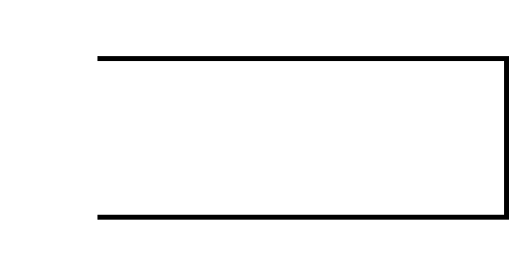
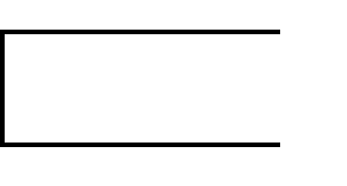
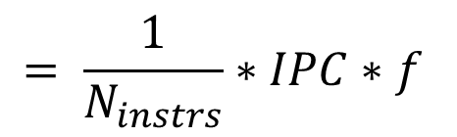
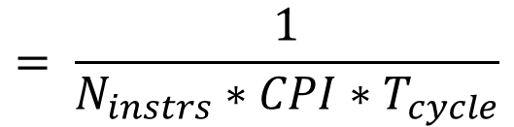


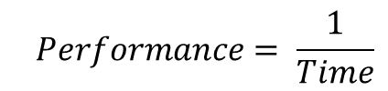
Performance
What does performance depend on?
$$Performance= \frac{1}{Time}$$
$$= \frac{1}{N_{instrs}∗CPI∗T_{cycle}}$$
$$= \frac{1}{N_{instrs}}∗IPC∗f$$
$$Time=Cycles∗T_{cycle}$$
$$=N_{instrs}∗CPI∗T_{cycle}$$
Golden rule of CS

Slide 28
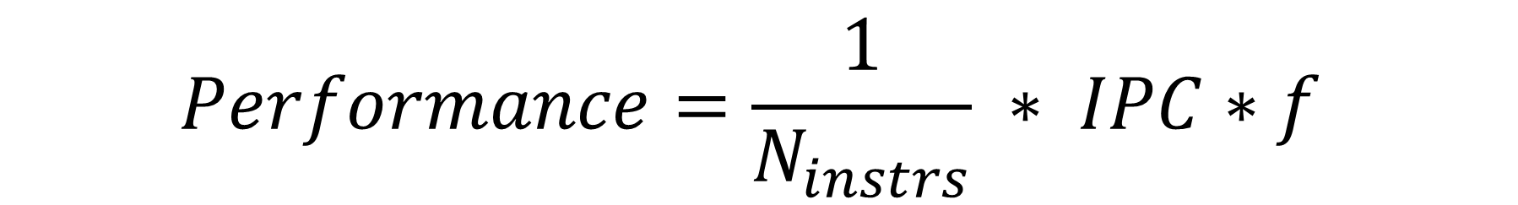
Increasing Performance
Better uArch: pipelining, caching, prediction, etc.
How can we increase it?
$$Performance=\frac{1}{N_{instrs}} ∗ IPC∗f$$
Better SW: algorithms, optimizations, ISA, etc.
Better design: faster circuits, smaller transistors, etc.

Slide 29
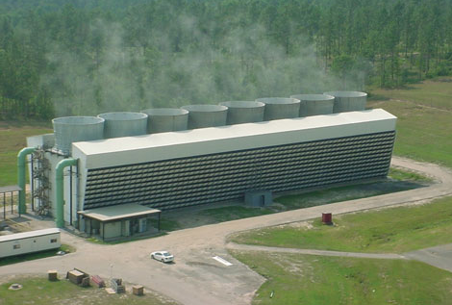
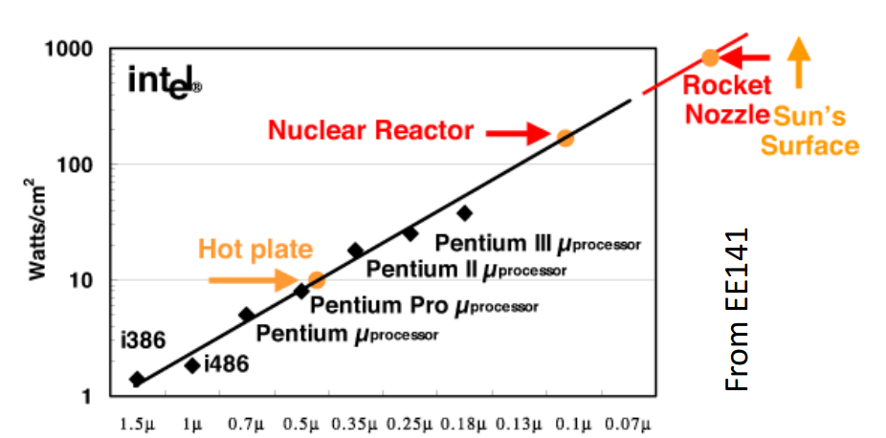
Power
Nuclear reactor? No, power supply for a large data center
Why is power important?
Less power -> smaller battery -> smaller/cheaper devices
Less power -> less money for electricity
Power Wall is reached
Cooling systems cannot dissipate more heat
We cannot spend more power even if we want

Slide 30
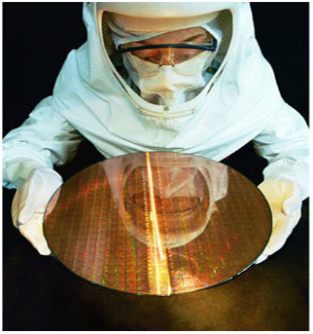
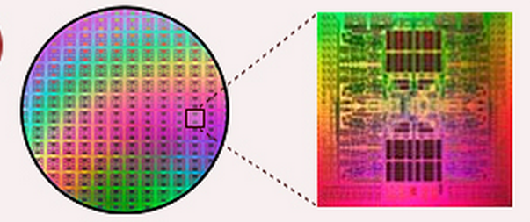
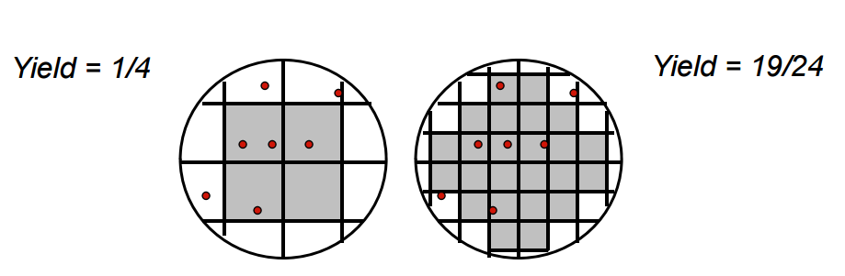
Cost
Fixed Cost (RnD)
Independent of volume (i.e., number of units made/sold)
Examples: design time and effort, mask generation, etc.
Variable Cost (manufacturing/production)
proportional to volume
Examples: silicon processing, packaging, test
Most of these related to chip area
The larger chip size the large production cost
Less chips on one wafer
Larger probability of error

Slide 31
ISA and uArch

Slide 32
ISA and uArch
Instruction Set Architecture (ISA) is a precise definition of:
computer instructions and features
mechanisms like procedures, interrupt/exception handler, etc.
some structures
An agreement between a programmer and an engineer:
It’s all programmer needs to program machine.
It’s all hardware designer needs to design machine.
Microarchitecture (uArch, implementation) is an organization and features of Hardware that executes instructions and support features defined in the ISA.

Slide 33
ISA and uArch
What a typical ISA defines
Data Formats. (Integer, Floating Point, Vector/Packed)
Instructions. (Operations, encoding, etc.)
Registers and Memory Organization.
Interrupts, exceptions, and traps.
Implementation-Dependent Features. (Memory control, custom features.)
What a typical uArch defines (not included into ISA)
Memory hierarchy organization (caches, buses, etc.)
Pipeline (forwarding, branch prediction, etc.)
Out-of-order executions … and many others.
they change the state
the programmer-visible state

Slide 34

Example: MIPS
An example of a RISC ISA.
Designed for easy programming and implementation.
Short and simple, but fast instructions → programs are larger than others, but IPC is higher.
The main aim was to take advantages of pipelined execution
Pipeline was not specified in ISA, but ISA developers tried to simplify its implementation in uArch.
Implementations:
The first one is R2000 (1986)
Later: R3000A (PlayStation), VR4300 (Nintendo⁶⁴), R4000 (PSP), R5900 (PlayStation 2)
Currently it is widely used in high-performance embedded systems, like MobileEye
One moment MIPS seemed to be overcome Intel IA-32...
It didn’t happen because Intel’s uArch was significantly better and could compensate the drawback of IA-32

Slide 35

Example: RISC-V
Pronounced “rick-five”
Another example of a RISC processor
Designed to fix MIPS design errors:
Well-defined instruction subsets
No obsolete instructions
Royalty-free
Implementations and toolchains are designed in universities
Potentially #1 competitor to ARM in microcontroller markets

Slide 36
Example: IA-32 and x86-64
An example of CISC ISA
Designed for laconic code and simpler assembler programming
CISC advantages are not important now
Became de-facto standard in 90-2000s because of Intel CPU quality
Incrementally extensions: MMX, SSE, AVX etc.
Polished toolchains and documentation

Slide 37
Data Formats
In the memory all including data and program code is presented as binary numbers:
Data representation:
Sizes: 8-b Bytes, 16-b Half words, 32-b words, 64-b double words
Formats: signed/unsigned integer, signed/unsigned floating point
0000 0010 | 0011 0010 | 0100 0000 | 0010 0000
=
=
0x2012620
add $t0, $s1, $s2

Slide 38



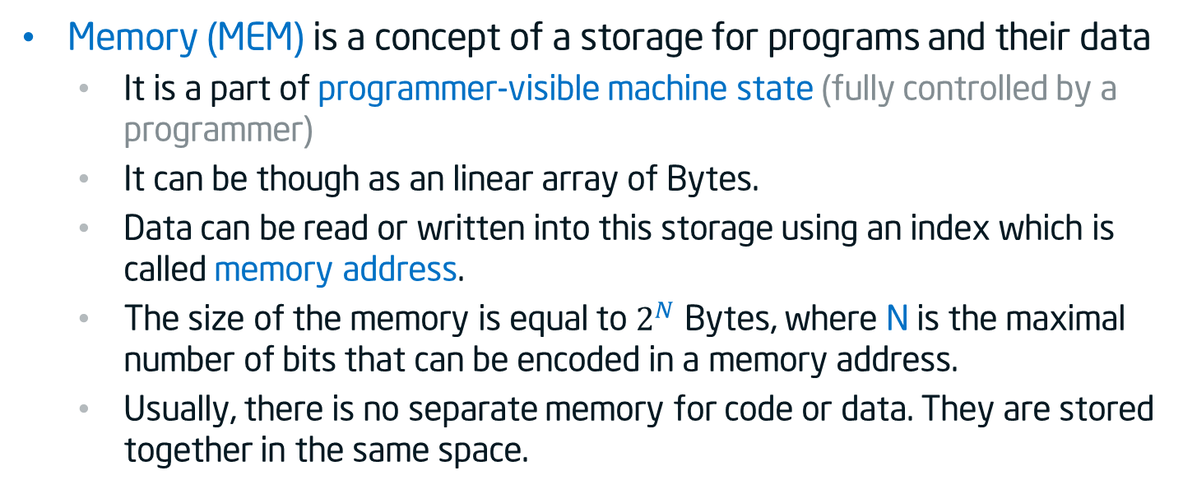
Memory addressing
Memory (MEM) is a concept of a storage for programs and their data
It is a part of programmer-visible machine state (fully controlled by a programmer)
It can be though as an linear array of Bytes.
Data can be read or written into this storage using an index which is called memory address.
The size of the memory is equal to $2^{N}$ Bytes, where N is the maximal number of bits that can be encoded in a memory address.
Usually, there is no separate memory for code or data. They are stored together in the same space.
0
1
2
$$2^{N−2}$$
$$2^{N−1}$$
$$2^{N}$$
…
00100100
…
…
…
…
…
8 bits = 1 Byte

Slide 39

Big and Little Endian
Historically numbers are being written from the right to the left (the most significant digit is on the right):
However, we enumerate elements in an array (and most other things) from the left to the right:
The question: if we put an value of two bytes (e.g. 256) at the beginning of the array where the most significant byte will be? In element 0 or element 1?
Decimal 537 = 7*${\text{10}}^{0}$ + 3*${\text{10}}^{1}$ + 5*${\text{10}}^{2}$
Decimal 537 = 7*${\text{10}}^{0}$ + 3*${\text{10}}^{1}$ + 5*${\text{10}}^{2}$
Binary 1101 = 1*${\text{2}}^{0}$ + 0*${\text{2}}^{1}$ + 1*${\text{2}}^{2}$ + 1*${\text{2}}^{3}$
Binary 1101 = 1*${\text{2}}^{0}$ + 0*${\text{2}}^{1}$ + 1*${\text{2}}^{2}$ + 1*${\text{2}}^{3}$
0
1
2
$$2^{N−2}$$
$$2^{N−1}$$
$$2^{N}$$
…
…
…
…
…
…
…

Slide 40
Big and Little Endian
The answer: it depends on the endianness of the ISA
Most significant byte
Least significant byte
Decimal 256 = Binary 0000 0001 | 0000 0000
Decimal 256 = Binary 0000 0001 | 0000 0000
Decimal 256 = Binary 0000 0001 | 0000 0000
15
8
7
0
0
1
2
0
1
2
Big Endian
Little Endian
00000001
00000000
00000000
10000000
15
8
0
7
7
0
8
15
Most of the modern ISAs are little-endian

Slide 41
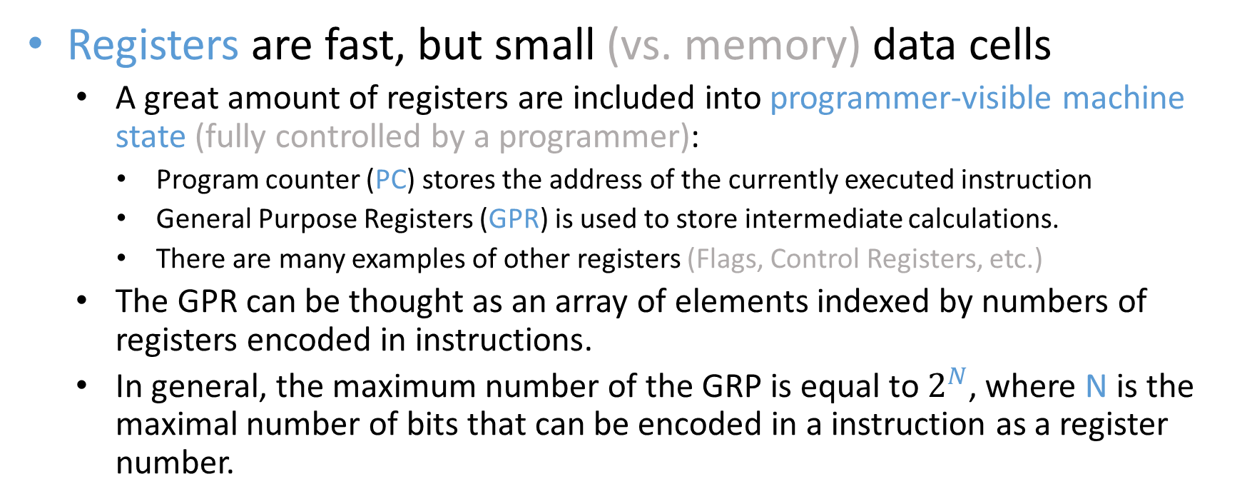
Registers
Registers are fast, but small (vs. memory) data cells
A great amount of registers are included into programmer-visible machine state (fully controlled by a programmer):
Program counter (PC) stores the address of the currently executed instruction
General Purpose Registers (GPR) is used to store intermediate calculations.
There are many examples of other registers (Flags, Control Registers, etc.)
The GPR can be thought as an array of elements indexed by numbers of registers encoded in instructions.
In general, the maximum number of the GRP is equal to $2^{N}$, where N is the maximal number of bits that can be encoded in a instruction as a register number.

Slide 42
Basic RISC operations
Move: set a register to constant value or value of other register
Load: move a value from memory/IO to register
Store: move a value from register to memory/IO
Arithmetic: addition, subtraction, multiplication, division
Logic: conjunction, disjunction, negation, exclusive disjunction
Comparison: equal, not equal, less, greater, less than etc.
Direct unconditional branch: jump directly to some code
Direct conditional branch: jump to some code conditionally (if/then)
Indirect branch: read address from register and jump to it (switch/case, returns)
System calls: call for resource managements by OS

Slide 43
Summary
What a typical ISA defines:
Data Formats: bit width, endianness
Registers and memory organization
Instructions — ‘rules’ to change registers and memory
Interrupts, exceptions, system calls, and traps.
But what does uArch define?
We’ll discuss it as soon as we look to the lower CS levels — gates, circuits, physics

Slide 44
Thank You

